Slide 1
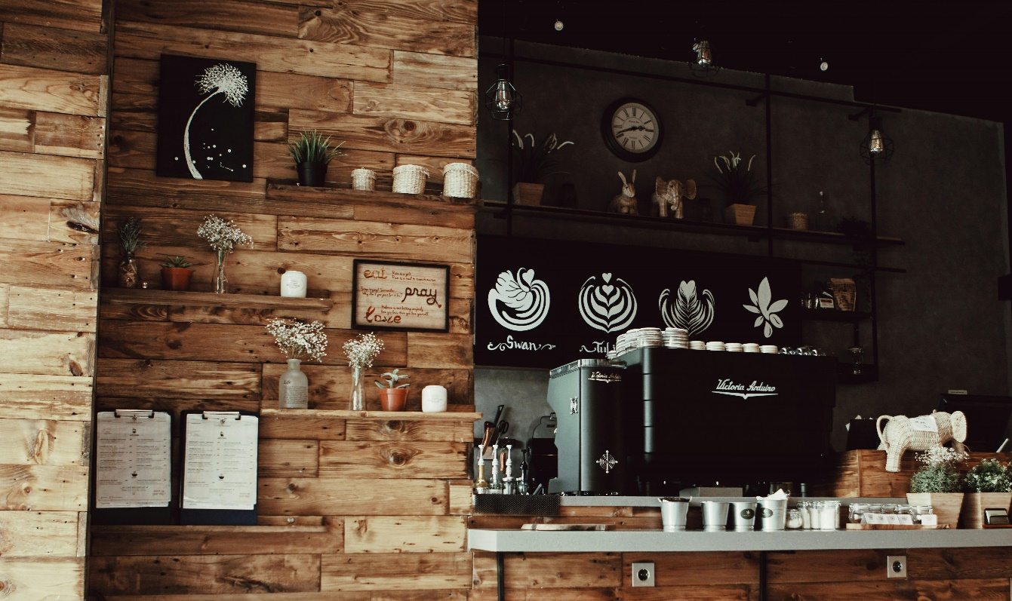
Bright coffee Analysis
Presented by Nothando Mkhomazi

Slide 2
Analysis
Observations
The most sold product is coffee, followed by tea.
The least sold products are packaged chocolate and flavors
Recommendations
Discontinue the sale of packaged chocolate.
Create promotions for the least sold products such as flavors, branded and loose tea

Slide 3
Analysis
Observations
During winter, the sales peak up as since on the month of May and June.
January and February interchange with the month with least sales.
Recommendations
Run discounts during January and February to increase sales.
Push afforatble items to attract price sensitive customers
Add breakfast combobs to increase foot traffic

Slide 4
Observations
Lower Manhattan is the busiest store compared to the other stores.
Consumers buy the products in the morning.
Other stores show steady sales and will need strategies o increase revenue.
Recommendations
Improve in store layout and product visibility for Astoria and Hell’s kitchen.

Slide 5
Insights
Coffee has the highest number of transactions leading by 6624, followed by tea with 5115.
Bakery has moderate transactions, it can improve by providing breakfast combos.
In order to increase the number of transactions for branded and loose tea, we offer get free muffins when you buy loose tea or branded

Slide 6
Insights
The morning (06:00-11:59) for all three stores produces the highest revenue.
Afternoon and the evening shows moderate sales.
From 19:00, the sales start to drop, and around 20:00 which is the night contributes zero sales

